Slide 1
Data Structures Workshop
Day 14

Slide 2
Workshop Outline
Sorting Algorithms!
Merge Sort
Quick Sort
Bucket/Radix Sort
Covering:
Sorting Algorithm Overview
Tracing
Implementations

Slide 3
Merge Sort

Slide 4
What is Merge Sort?
The Merge Sort algorithm uses the “divide and conquer” method where we divide the problem into subproblems and solve the subproblems individually.
Subproblems are then combined to form the final solution!
Merge Sort specifically divides a given array into two equal halves and then they are combined in a sorted manner.
Basically though, keep splitting the array in half until each sublist has 1 element, then merge everything back together in a sorted manner

Slide 5
Merge Sort Implementation
We’re going to have 2 functions to help us perform the Merge Sort algorithm:
mergeSort() → repeatedly splits the array into two halves until we try to perform the mergeSort() function on a subarray of size 1
merge() → picks up sorted subarrays and merges them to eventually sort the entire array

Slide 6
Merge Sort Implementation
Find the middle of the array​
Recursively split the array into subsections​ (mergeSort())
Using two recursive calls (one for the left subarray, another for the right subarray)​
Left subarray starts from left, stops at mid​
Right subarray starts from mid + 1, stops at right​
Stop when left is greater than or equal to right (BASE CASE), means stopping when each subarray only has one element​
Call your merge function which merges the right and left subarrays together, sorts as you merge​ (merge())

Slide 7
Merge Sort Tracing
Let’s say we have an array with elements: 12, 23, 2, 43, 51, 35, 19, 4
Trace the Merge Sort algorithm on this array!

Slide 8
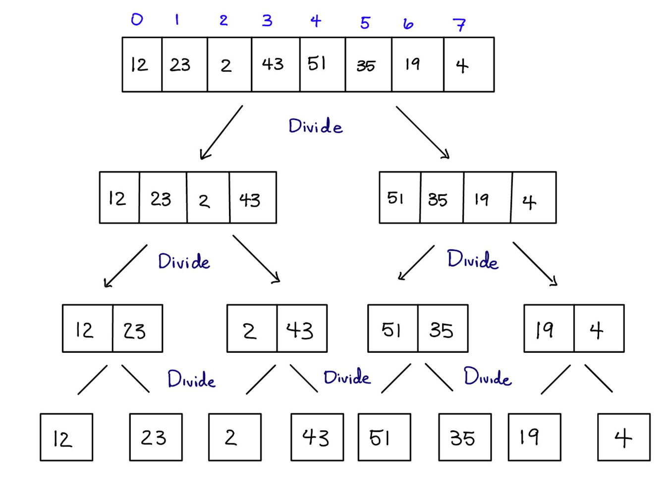
mergeSort()
Function!

Slide 9
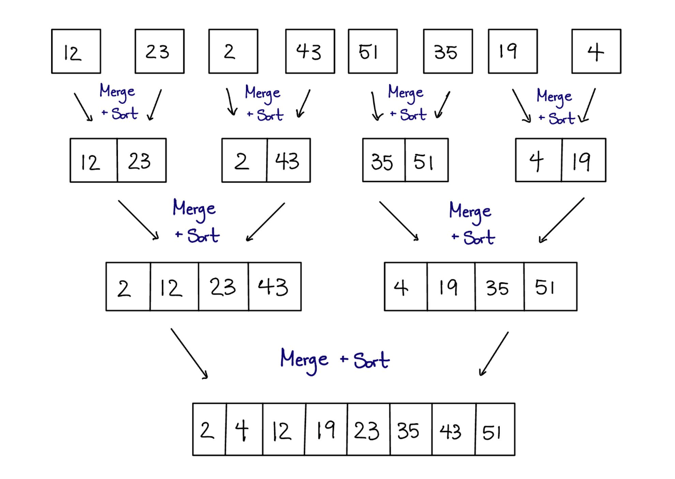
merge()
Function!

Slide 10
Trace Yourself
Let say we have an array with elements: [15, 5, 24, 8, 1, 3, 16, 10] and trace them using merge sort.

Slide 11
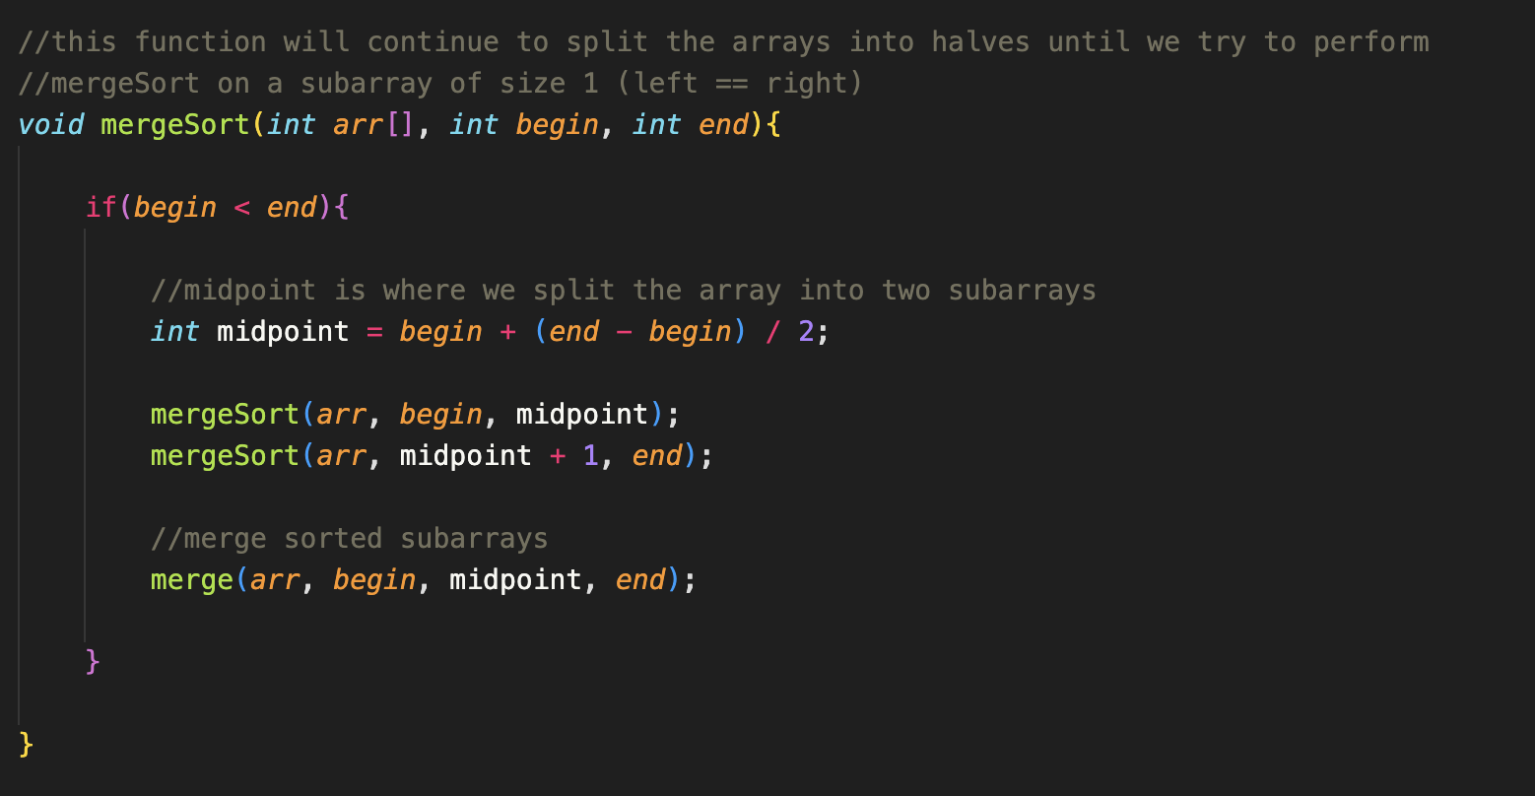
mergeSort() Function

Slide 12
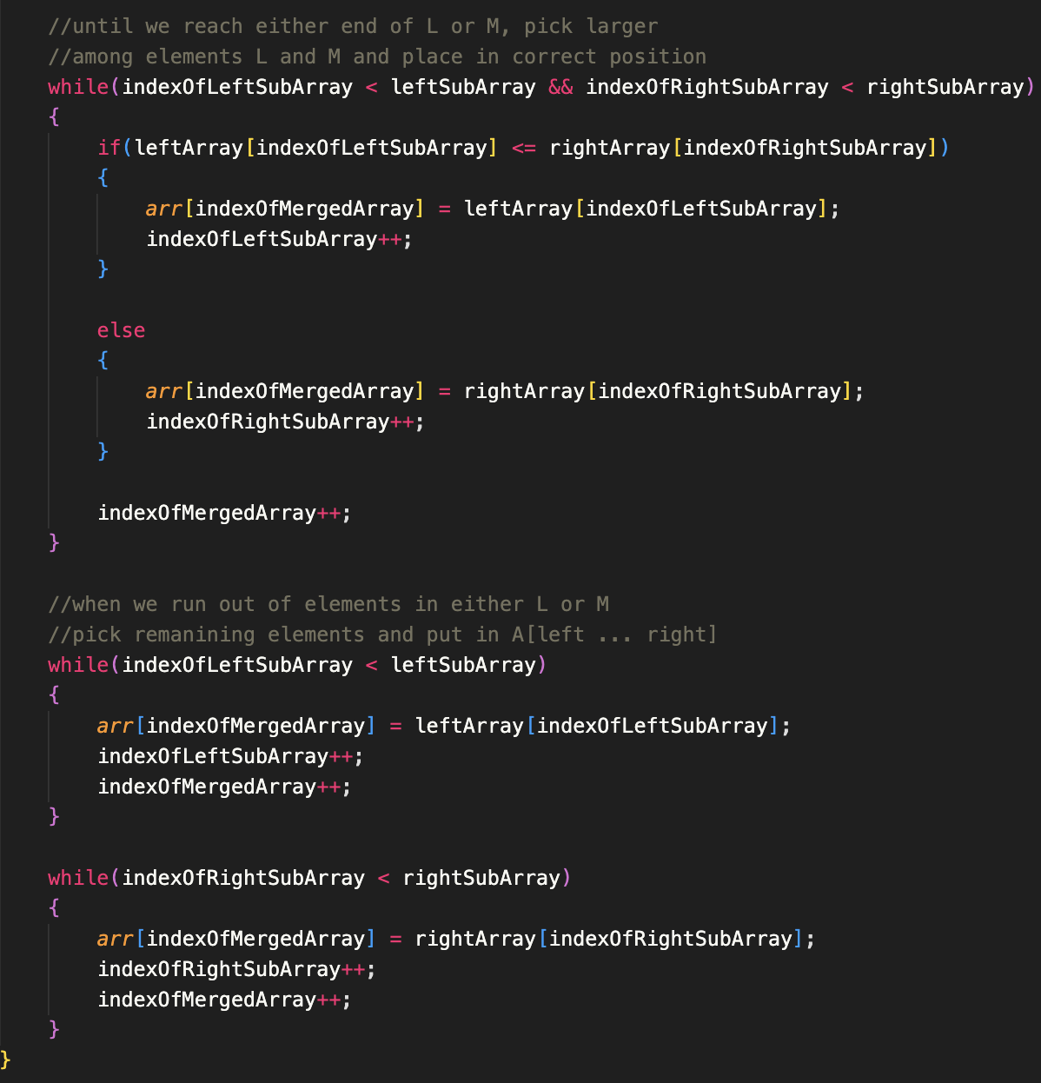
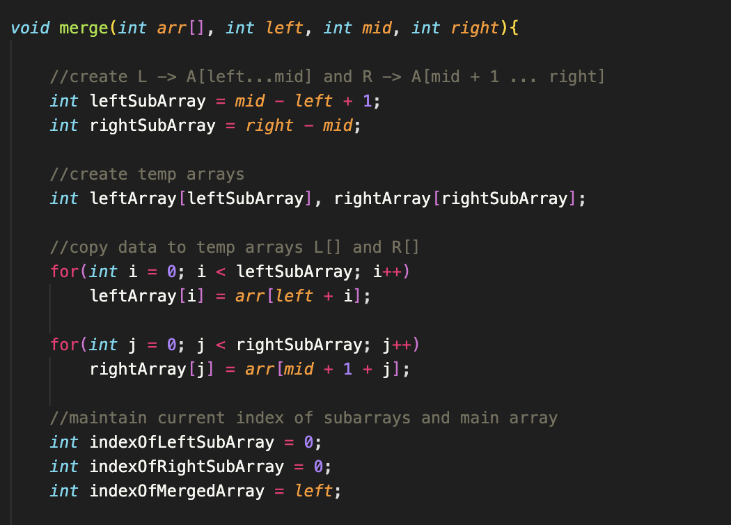
merge() Function

Slide 13
Quick Sort

Slide 14
What is Quick Sort?
As the name suggests, quick sort is a relatively fast divide and conquer sorting algorithm.
In quick sort, we pick a pivot element (there are many variations of quick sort, but for the sake of this class, we’ll be picking the last element of an array as the pivot element).
We want to position the pivot in a place where all elements to the left of it are of less value than the pivot, and where all elements to the right of it are greater than the pivot.

Slide 15
At this point, the elements to the left of the pivot and right of the pivot make up 2 different subarrays.
We then sort these two subarrays in the same manner as previously described until each subarray is made up of only one element.
When this happens, the array is now sorted and we can merge all the subarrays together.

Slide 16
Quick Sort Implementation
Pick a pivot as last element
Call partition for the array​
Recursive function that essentially puts the pivot in the right place (if ascending, all elements to the left of the pivot are less & elements to the right are greater)​
i and j keep track of the elements to swap​
i starts at low – 1, while j starts at low and ends at high – 1 (j iterates through the array)​
If the element at j is less than the pivot, then increment i and swap the element at I and j​
Keep going until j reaches high – 1​
At the end, swap the element at i and the element at the pivot (which is high in this case)​
Return the index where the pivot is located at now​
Call quicksort for both sides of the array​

Slide 17
Quick Sort Tracing
Let’s say we have an array with elements: 3, 12, 15, 9, 6, 2, 10
Trace the Quick Sort algorithm on this array!

Slide 18
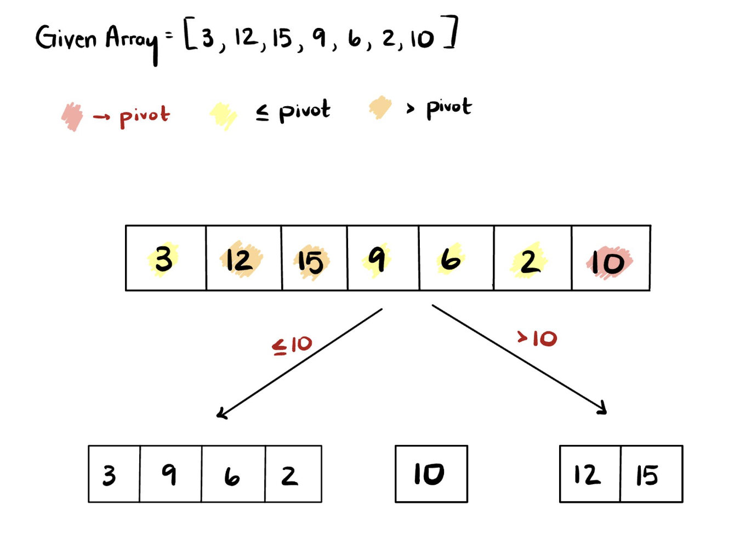
1st Pass

Slide 19
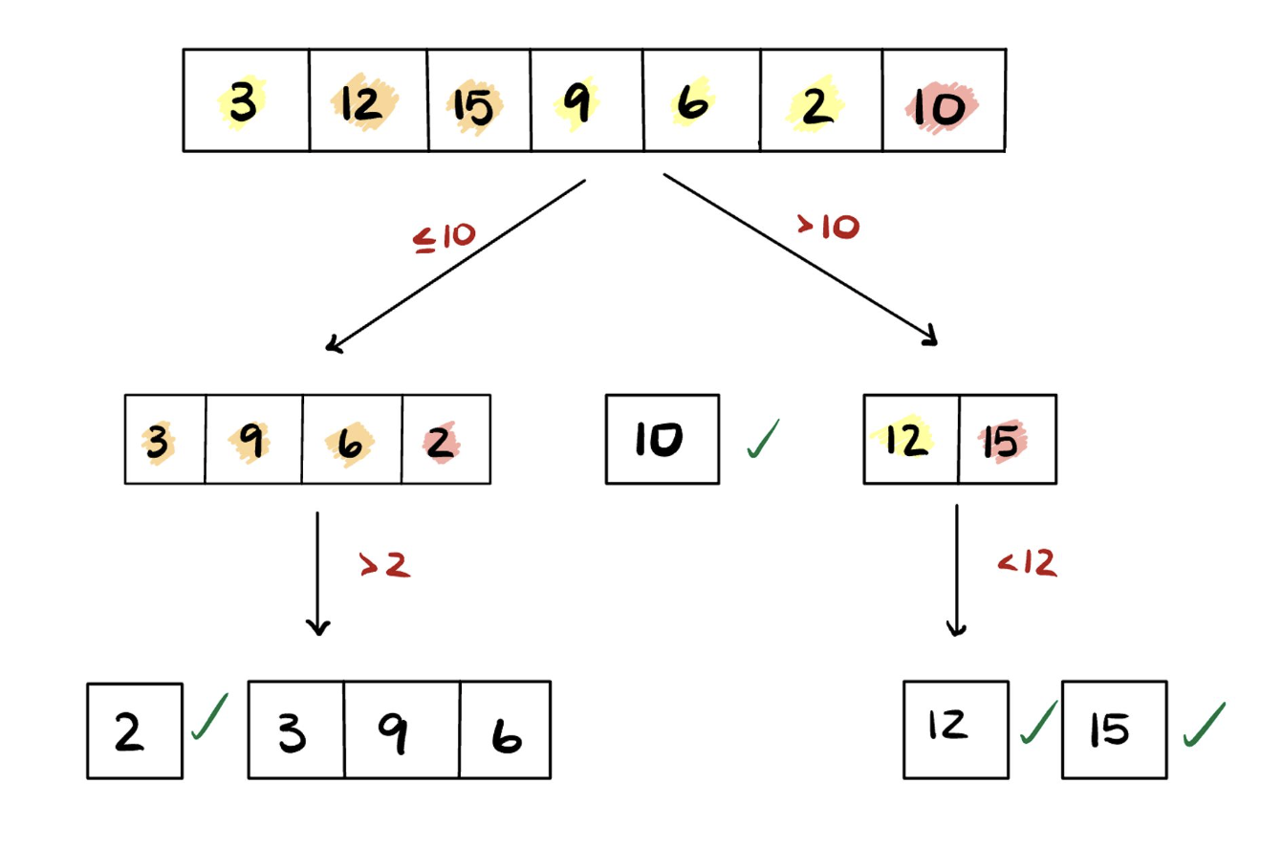
2nd Pass

Slide 20
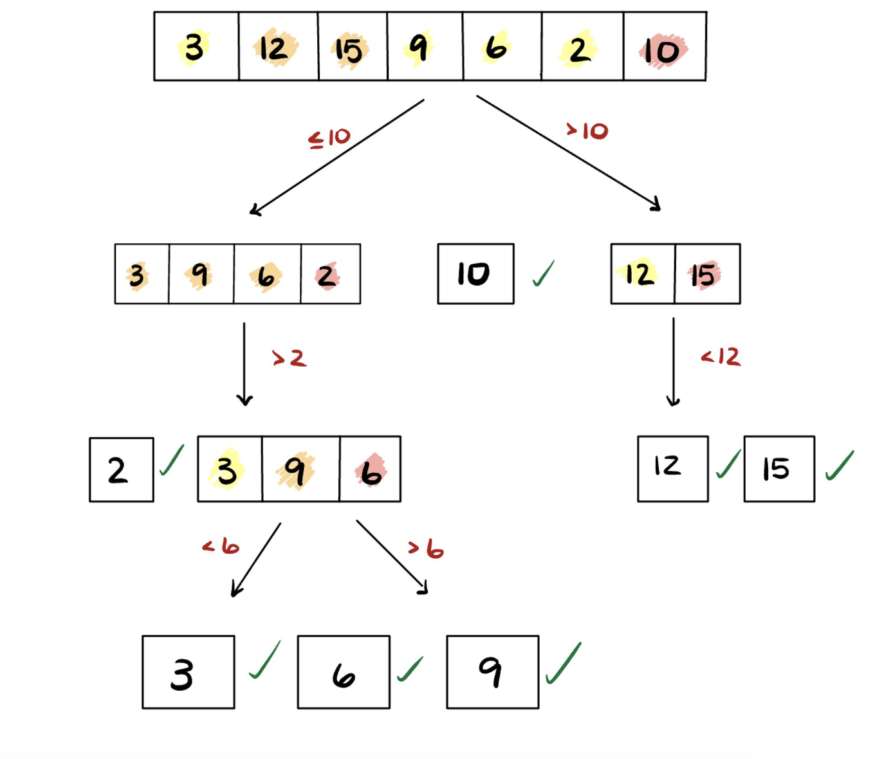
Last Pass

Slide 21
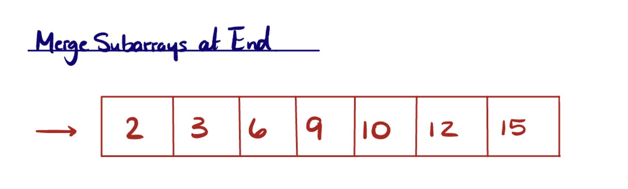

Slide 22
Trace Yourself
Let say we have an array with elements: [15, 5, 24, 8, 1, 3, 16, 10] and trace them using Quick Sort.

Slide 23
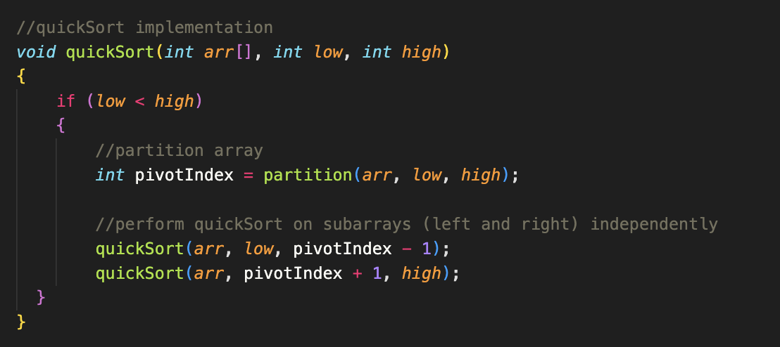
quickSort() Function

Slide 24
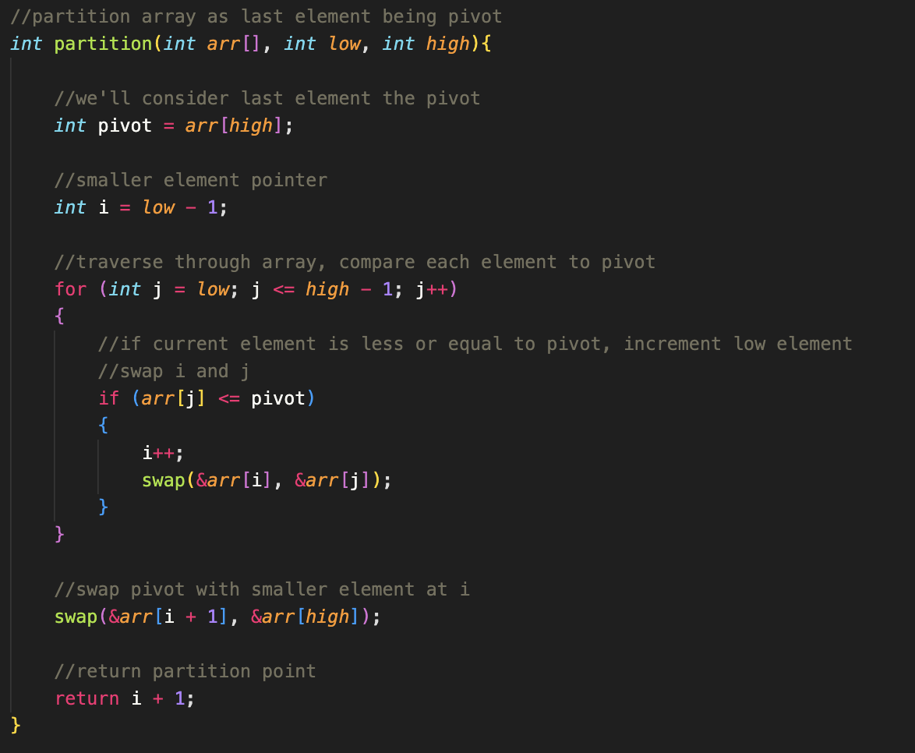
partition() Function

Slide 25
Bucket (Radix) Sort

Slide 26
Bucket Sort
NOTE: Dr. Rizk calls this Bucket Sort, but is referred to as Radix Sort when looking up implementations of it online
Bucket Sort does digit by digit sorting, starting from least significant digit, to most significant digit.
For every iteration of the bucket sort (will iterate for the max number’s number of digits), we’ll generate 10 buckets (implemented as queues). We’ll add numbers to their respective bucket depending on the digit’s value.
We’ll be using these buckets to sort these values, digit by digit. If any of this seems confusing, look at the hand tracing of the sort for clarification.

Slide 27
Bucket Sort Tracing
Let’s say we have an array with elements: 391, 625, 907, 14, 2259, 573
Trace the Bucket Sort algorithm on this array!

Slide 28
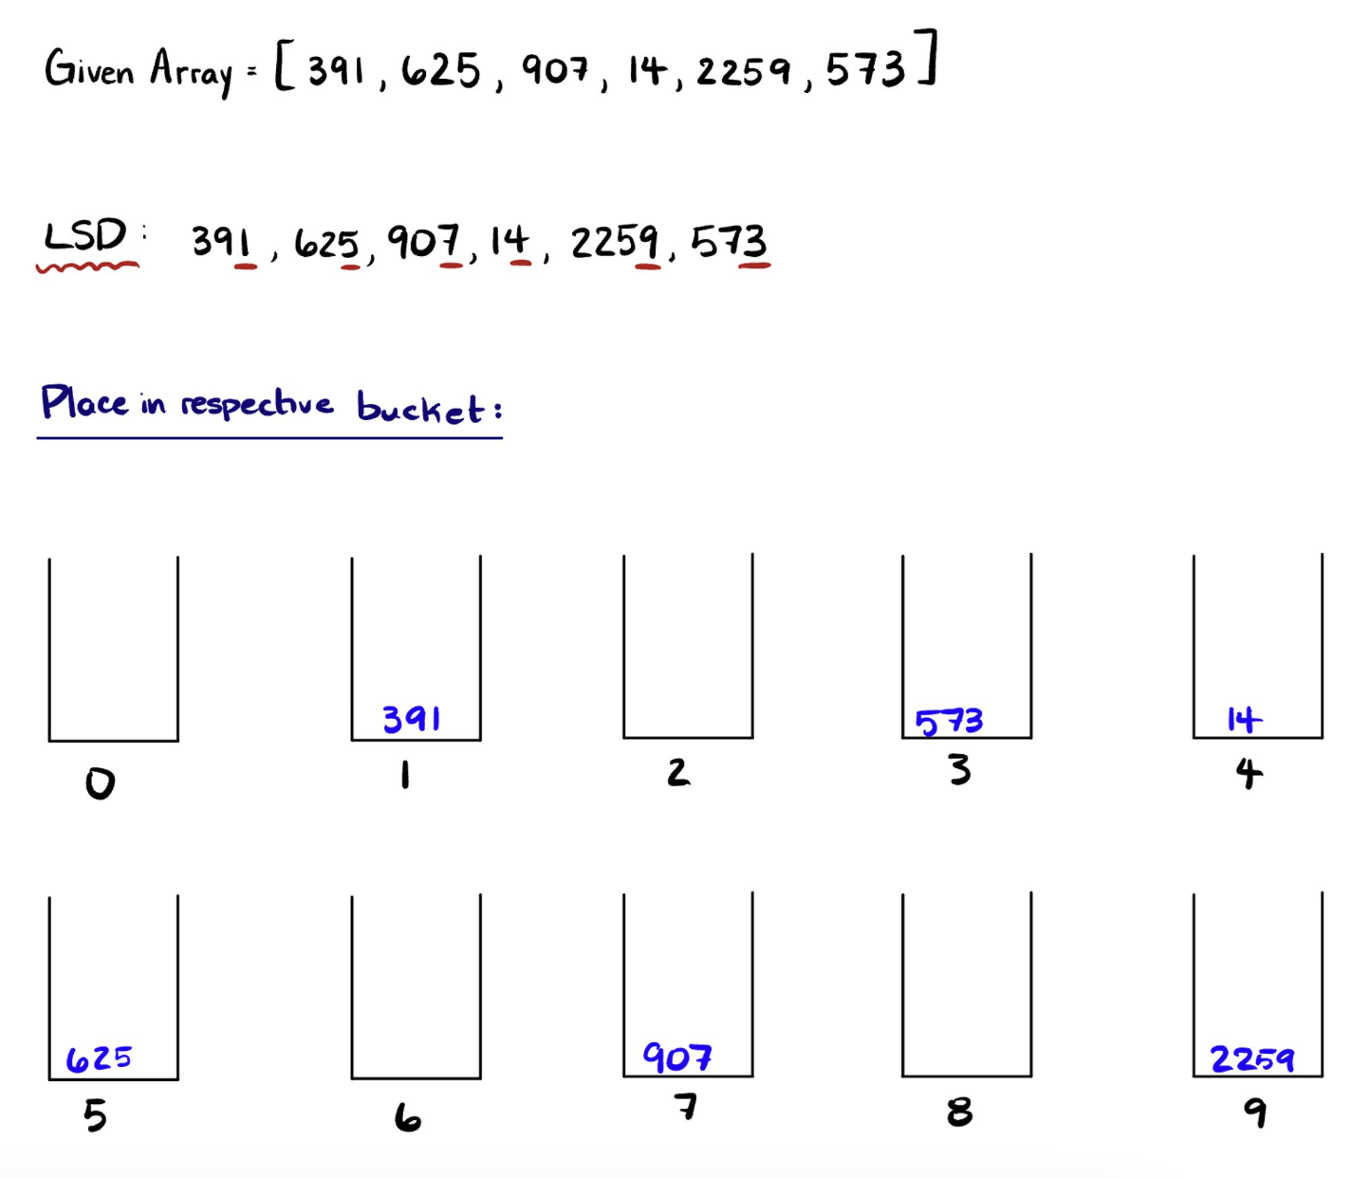
1st Iteration

Slide 29
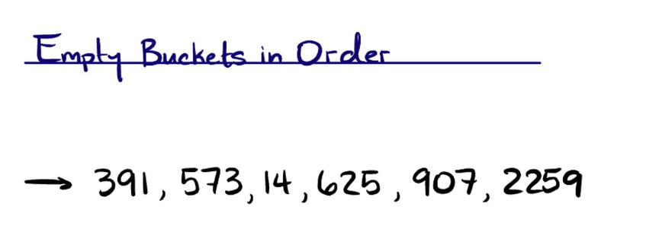

Slide 30
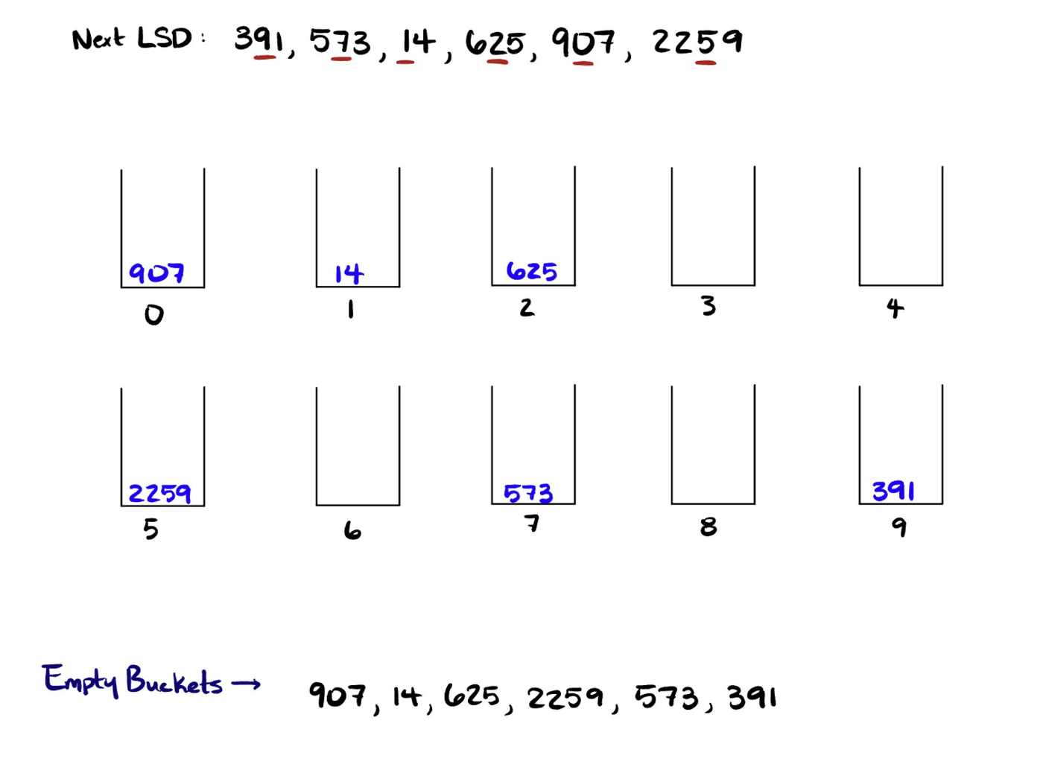
2nd Iteration

Slide 31
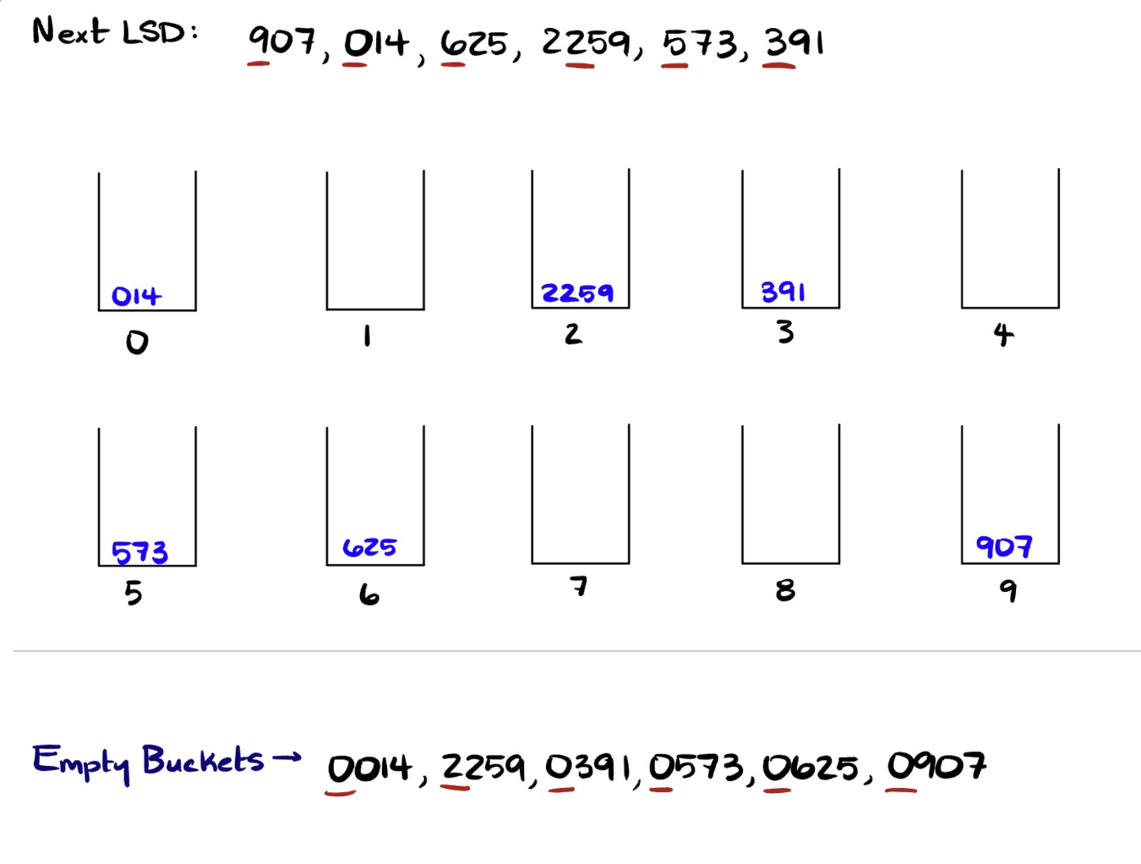
3rd Iteration

Slide 32
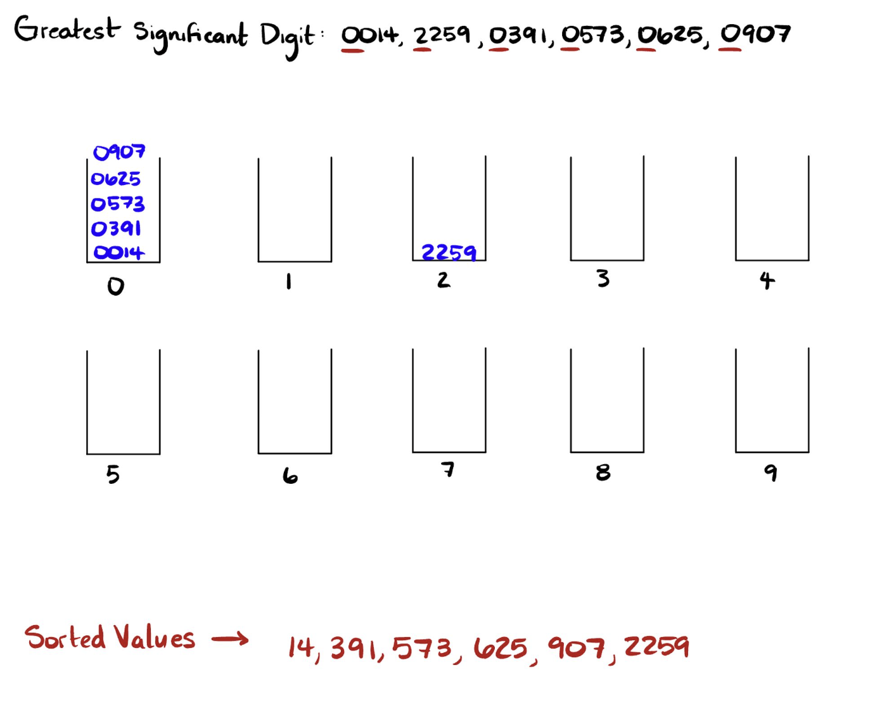
Last Iteration

Slide 33
Trace Yourself
Sort the array with elements: [904, 046, 005, 074, 062, 001] and trace them using Bucket Sort.

Slide 34
Sorting Algorithm Tips
This website will be your best friend: https://visualgo.net/en/sorting

